Slide 1
EMTH403
Mathematical Foundation for Computer Science

Slide 2
Lecture Outcomes
understand the use of product rule, sum rule and subtraction rule in the basics of counting.
understand the use of tree diagram in the basics of counting.

Slide 3
Basics of Counting – Example 1
Ques:- In a version of the computer language BASIC, the name of a variable is a string of one or two alphanumeric characters, where uppercase and lowercase letters are not distinguished. (An alphanumeric character is either one of the 26 English letters or one of the 10 digits.) Moreover, a variable name must begin with a letter and must be different from the five strings of two characters that are reserved for programming use. How many different variable names are there in this version of BASIC?

Slide 4
Basics of Counting – Example 1
AA
AB
AC
AD
…
AZ
BA
BB
BC
BD
…
BZ
CA
CB
CC
CD
…
CZ
A
B
C
D
…
Z
ZA
ZB
ZC
ZD
…
ZZ
26
26
26
26
26
……….
A0
A1
A2
…
A9
B0
B1
B2
…
B9
C0
C1
C2
…
C9
Z0
Z1
Z2
…
Z9
10
10
10
10
=26 + 36 + 36 + 36 + 36
=26 + 26*36
ANSWER = 26 + 26*36 - 5(RESERVED) = 26+931=957

Slide 5
Basics of Counting – Example 2
Ques:- How many strings are there of lowercase letters of length four or less, not counting the empty string?
Sol:- By the sum rule we can count the number of strings of length 4 or less by counting the number of strings of length i, for 0 ≤ i ≤ 4, and then adding the results.

Slide 6
Basics of Counting – Example 2
Ques:- How many strings are there of lowercase letters of length four or less, not counting the empty string?
Null
1 Letter
a
b
c
…
…
z
2 Letters
aa
Ab
..
ba
bb
…
zz
3 Letters
aaa
Aab
..
baa
bab
…
zzz
4 Letters
aaaa
Aaab
..
baaa
baab
…
zzzz
=1 + 26 + 26.26 + 26.26.26 + 26.26.26.26
=26⁰ + 26¹ + 26² + 26³ + 26⁴
= 1 + 26 + 676 + 17576 + 456976 = 475,255

Slide 7
Basics of Counting – Example 3
Ques:-Suppose that a password for a computer system must have at least 8, but no more than 12, characters, where each character in the password is a lowercase English letter, an uppercase English letter, a digit, or one of the six special characters ∗, >, <, !, +, and =. How many different passwords are available for this computer system?

Slide 8
Basics of Counting – Example 3
Sol:- We are told that there are 26 + 26 + 10 + 6 = 68 available characters.
A password of length k using these characters can be formed in 68^{k} ways.
Therefore the number of passwords with the specified length restriction is 68⁸ + 68⁹ + 68¹⁰ + 68¹¹ + 68¹².

Slide 9
Basics of Counting – Example 3
8 Letters
aaaaaaaa
..
zzzzzzzz
AAAAAAAA
…
ZZZZZZZZ
∗ ∗ ∗ ∗ ∗ ∗ ∗ ∗
∗ ∗ ∗ ∗ ∗ ∗ ∗ ∗ >
….
= = = = = = = =
9 Letters
aaaaaaaaa
..
zzzzzzzzz
AAAAAAAAA
…
ZZZZZZZZ
∗ ∗ ∗ ∗ ∗ ∗ ∗ ∗
∗ ∗ ∗ ∗ ∗ ∗ ∗ >
….
= = = = = = = =
12 Letters
aaaaaaaaaaaa
..
zzzzzzzzzzzz
AAAAAAAAAAAA
…
ZZZZZZZZZZZ
∗ ∗ ∗ ∗ ∗ ∗ ∗ ∗ ∗ ∗
∗ ∗ ∗ ∗ ∗ ∗ ∗ ∗ ∗ >
….
= = = = = = = = = = =
………..
=68⁸ + 68⁹ + 68¹⁰ + 68¹¹ + 68¹²

Slide 10
Basics of Counting – Example 4
Ques:- Each user on a computer system has a password, which is six to eight characters long, where each character is an uppercase letter or a digit. Each password must contain at least one digit. How many possible passwords are there?

Slide 11
Basics of Counting – Example 4
Total password, which are six characters long
0
1
2
..
9
a
b
…
z
0
1
2
..
9
a
b
…
z
0
1
2
..
9
a
b
…
z
0
1
2
..
9
a
b
…
z
0
1
2
..
9
a
b
…
z
0
1
2
..
9
a
b
…
z
a
b
…
z
a
b
…
z
a
b
…
z
a
b
…
z
a
b
…
z
a
b
…
z
-
Passwords with no digits
=36*36* 36*36* 36*36 - 26*26* 26*26* 26*26
=36⁶- 26⁶

Slide 12
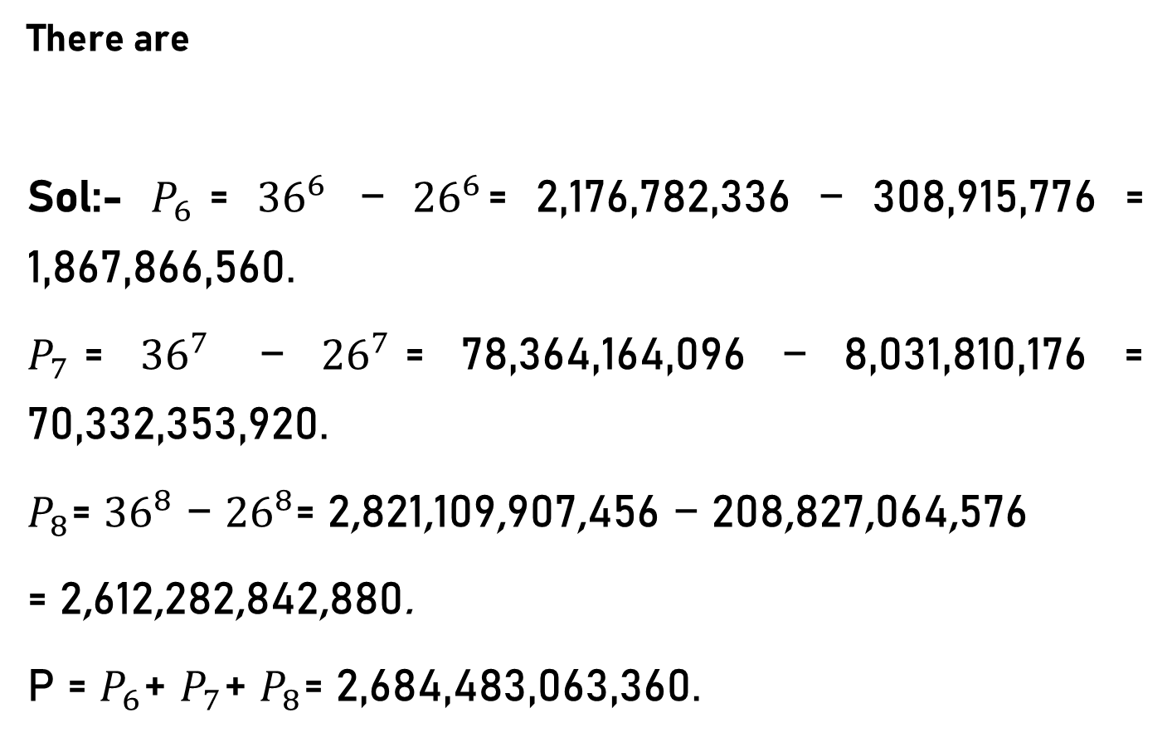
Basics of Counting – Example 4
There are
Sol:- $P_{6}$= ${36}^{6}$ − ${26}^{6}$= 2,176,782,336 − 308,915,776 = 1,867,866,560.
$P_{7}$= ${36}^{7}$ − ${26}^{7}$= 78,364,164,096 − 8,031,810,176 = 70,332,353,920.
$P_{8}$= ${36}^{8}$ − ${26}^{8}$= 2,821,109,907,456 − 208,827,064,576
= 2,612,282,842,880.
P = $P_{6}$+ $P_{7}$+ $P_{8}$= 2,684,483,063,360.

Slide 13
Basics of Counting – Example 5
Ques:- How many strings of five ASCII characters contain the character @ (“at” sign) at least once? [Note: There are
128 different ASCII characters].
Sol:- The easiest way to count this is to find the total number of ASCII strings of length five and then subtract off
the number of such strings that do not contain the @character.

Slide 14
Basics of Counting – Example 5
=Total -
Without @character.
= n₁* n₂* n₃* n₄* n₅ - m₁* m₂* m₃* m₄* m₅
=128*128*128* 128*128 - 127*127*127* 127*127
=128⁵ - 127⁵
= 34,359,738,368 - 33,038,369,407
= 1,321,368,961

Slide 15
Basics of Counting – Example 6
Ques:- A computer company receives 350 applications from computer graduates for a job planning a line of newWeb servers.
Suppose that 220 of these applicants majored in computer science, 147 majored in business, and 51 majored both in computer science and in business.
How many of these applicants majored neither in computer science nor in business?

Slide 16
Basics of Counting – Example 6
220 of these applicants majored in computer science,
147 majored
in business
|C1 ∪ B2| = |C1| + |B2| − |C1 ∩ B2| = 220 + 147 − 51 = 316
receives 350 applications from computer graduates
51 majored both
We conclude that 350 − 316 = 34 of the applicants majored neither in computer science nor in business.

Slide 17
Tree Diagrams – Example 1
Ques:- Suppose that “I Love New Delhi” T-shirts come in five different sizes: S, M, L, XL, and XXL.
Further suppose that each size comes in four colors, white, red, green, and black, except for XL, which comes only in red, green, and black, and XXL, which comes only in green and black.
How many different shirts does a souvenir shop have to stock to have at least one of each available size and color of the T-shirt?

Slide 18
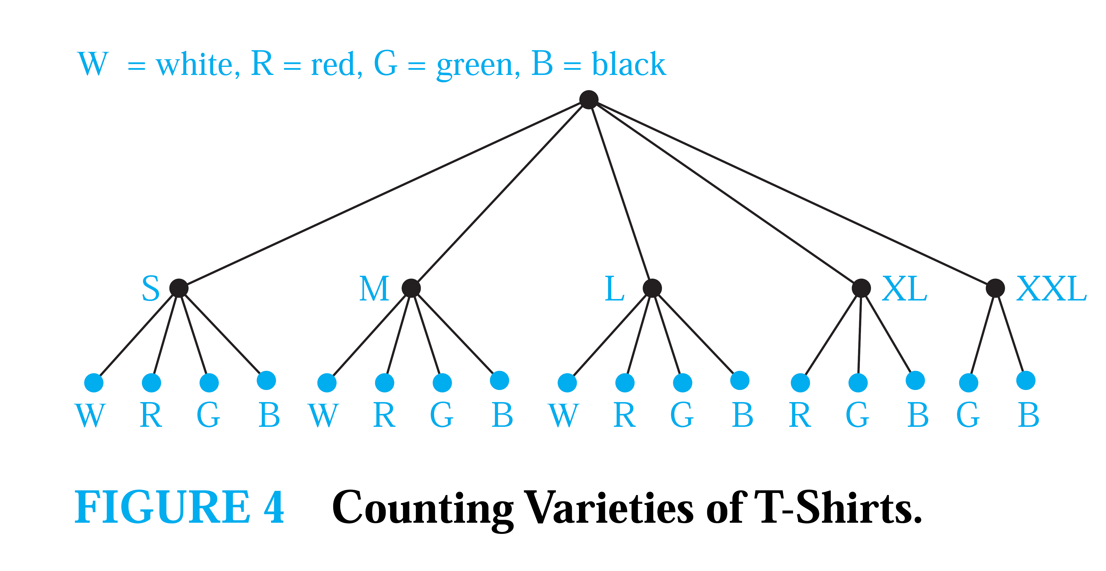
Tree Diagrams – Example 1
The tree diagram in above displays all possible size and color pairs.
It follows that the souvenir shop owner needs to stock 17 different T-shirts.

Slide 19
Tree Diagrams – Example 2
Ques:- How many bit strings of length four do not have two consecutive 1s?
The tree diagram displays all 8-bit strings of length four without two consecutive 1s.
There are eight-bit strings of length four without two consecutive 1s.

